Slide 1
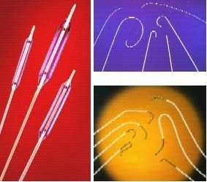
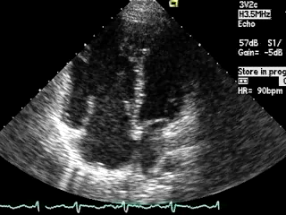
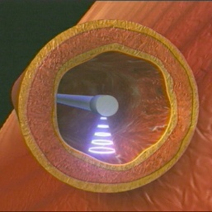
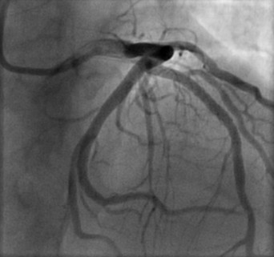
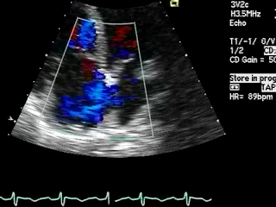
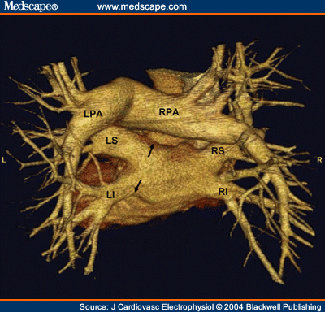
Cath Lab Essentials: Basic Hemodynamics for the Cath Lab and ICU
Ailin Barseghian El-Farra, MD, FACC
Assistant Professor, Interventional Cardiology
University of California, Irvine
Department of Cardiology

Slide 2
Right Heart Catheterization

Slide 3
INDICATIONS
Cause of shock
Pulmonary hypertension
Fluid management and hemodynamic monitoring
Diagnosis of left to right shunt
Guidance for pericardial tamponade
Constrictive versus restrictive cardiomyopathy
Notes:
Diagnostic and therapeutic indications:
Differentiate cause of shock or pulmonary edema
Evaluation for pulmonary hypertension
Guide fluid management and hemodynamic monitoring after surgery, complicated MI, shock, etc..
Diagnosis of left to right shunt
Differentiation of pericardial tamponade from constrictive and restrictive cardiomyopathy

Slide 4
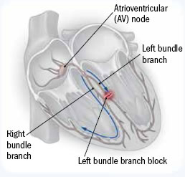
CONTRAINDICATIONS
ABSOLUTE contraindications:
None
CAUTION:
Pulmonary hypertension
Elderly
Left bundle branch block
Notes:
Most common complications are due to venous access, arrhythmias from RVOT stimulation including VT, AV block, or RBBB. Significant but transient ventricular arrhythmias occur in 30-60% of pts who undergo RHC and are self-limited and do not require treatment. Arrhythmia resolves when catheter is readjusted. Sustained ventricular arrhythmias can happen in sick/unstable pts. In pts with LBBB, a temp pacemaker may be necessary if RBBB occurs during RHC.

Slide 5
EQUIPMENT
Transducer
Fluid-filled (high pressure) tubing connects the catheter to the transducer
Physiologic recorder to display, analyze, and store the hemodynamic waveforms
Notes:
1. Pressure waveform is transmitted from the catheter tip to the transducer through a column of fluid.
2. The transducer is the essential component that translates the mechanical forces to electrical signals. (Transducers consist of a diaphragm or membrane (attached to a strain-gauge-Wheatstone bridge arrangement).)
3. When a fluid wave strikes the diaphragm, an electrical current is generated with a magnitude dependent on the strength of the force that deflects the membrane. The output current is amplified and displayed as pressure versus time.
-larger catheters give better tracings; shorter tubing is better
1. “The catheter used to sample pressure is connected to a high-pressure tubing (arrow).
2. The high-pressure tubing connecting to the patient attaches by a stopcock to the transducer (a). A close-up view of the transducer is shown in B (arrow).
3. Another stopcock allows flushing and equilibration with air (b).
4. The transducer connects by a cable to the hemodynamic computer (c).”

Slide 6
EQUIPMENT
Notes:
The Swan-Ganz catheter is the most commonly used to measure RH pressures.
1. balloon at the tip for floatation – controlled by “c” (The balloon inflates up to 1.5 cc)
2. End-hole (distal port)
3. 10 cm markings - catheter has 10 cm increment markings
4. Side hole (30 cm from catheter tip -> prox port)
5. Extra port
6. Thermistor for measurement of thermodiluation CO.
-The optimal catheter for hemodynamic measurements is stiff to transmit the pressure wave to the transducer without absorption by the catheter, is easy and safe to position, and has a relatively large lumen opening to an end hole.
-the catheter as well as the tubing connecting the catheter and transducer should be as short as possible, with as few connections as possible to prevent timing delays, pressure damping, and a potential source of air bubbles.

Slide 7
TECHNIQUE

Slide 8
A Systematic Approach to Hemodynamic Interpretation
1. Establish the zero level and balance transducer.
2. Confirm the scale of the recording.
-40 mmHg for RHC, 200 mmHg for LHC
3. Collect hemodynamics in a systematic method using established protocols.
4. Critically assess the pressure waveforms for proper fidelity.
5. Carefully time pressure events with the ECG.
6. Review the tracings for common artifacts

Slide 9
Components of a Right Heart Catheterization
Right atrium
Mean (1-5 mmHg)
Right ventricle
Phasic (25/5 mmHg)
Pulmonary capillary wedge
Mean (7-12 mmHg)
Pulmonary artery
Phasic and mean (25/10 mmHg; mean 10-20 mmHg)
Notes:
Definition of pulm htn is mean PA pressure > 25 mmHg with PCWP < 15 mmhg

Slide 10
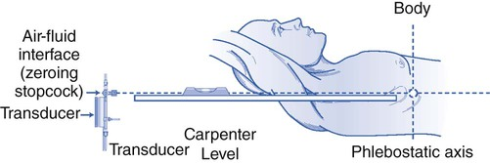
Precautions
Always record pressures at end-expiration
During inspiration, pressures will be lower due to decrease in intrathoracic pressure
Always zero and reference the system
Notes:
Table-mounted transducers do require balancing or ‘‘zeroing,’’ which refers to the establishment of a reference point for subsequent pressure measurements. The reference or ‘‘zero’’ position should be determined before any measurements are made. By convention, it is defined at the patient’s midchest in the anteroposterior dimension at the level of the sternal angle of Louis (fourth intercostal space). This site is an estimation
of the location of the right atrium and is also known as the phlebostatic axis. A table-mounted transducer is placed at this level and the stopcock is opened to air (atmospheric pressure) and set to zero by the hemodynamic system.
--Positive end expiratory pressure increases alveolar pressure, reducing the proportion of lung zone 3. In addition, the positive
pressure is transmitted to the central
Chapter 2—Normal Waveforms, Artifacts, and Pitfalls 25
circulation, directly affecting right-sided
pressures and leading to an overestimation
of the PCWP.
-The general consensus is that PEEP less than 10 cm H2O does not significantly affect the PCWP. Still, debate
-One suggested method for correction is based on the observation that PCWP rises 2–3 cm for every 5 cm H2O increment in PEEP.

Slide 11
Simultaneous Right- and Left-Heart Catheterization
Pulmonary artery (PA) catheter to PA
Measure thermodilution (x3) cardiac output and/or measure oxygen saturation in PA and AO blood samples to determine Fick output and screen for shunt.
Record aortic pressures with AO catheter. Cross the AV into the ventricle -> Wedge the PA catheter -> Measure simultaneous LV-PCWP (mitral valve assessment).
Pull back from PCWP to PA.
Pull back from PA to right ventricle (RV) (to screen for pulmonic stenosis) and record RV.
Record simultaneous LV-RV (constriction vs restriction).
Pull back from RV to right atrium (RA) (to screen for tricuspid stenosis) and record RA
Pull back from LV to AO (to screen for aortic stenosis).

Slide 12
CARDIAC CYCLE

Slide 13
PHASES
1: Atrial Contraction
2: Isovolumic Contraction
(TV/MV closure to PV/AV opening)
3: Rapid Ejection
4: Reduced Ejection
(PV/AV opening to PV/AV closure)
5: Isovolumic Relaxation
(PV/AV closure to TV/MV opening)
6: Rapid Ventricular Filling
7: Reduced Ventricular Filling
(TV/MV opening to TV/MV closure)
Notes:
demonstrates the three basic waveforms (atrial, ventricular, and arterial) and their relationships to key electrical and physiologic events during the normal cardiac cycle.ve

Slide 14
PRESSURE WAVE INTERPRETATION

Slide 15
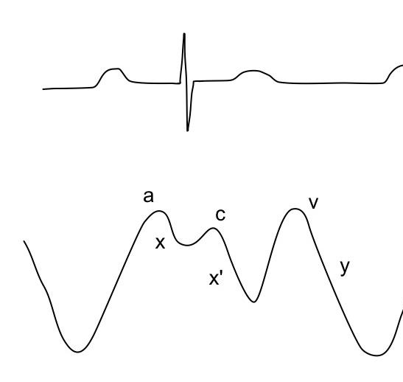
Notes:
Electrical precedes mechanical
• ‘a’ wave increase in pressure during atrial contraction (PR interval- ECG)
• ‘x’ descent the fall in pressure following the a wave (represents atrial relaxation)
• ‘c’ wave may occur as an interruption to the x descent and represents the movement of the AV valve towards the atrium during valve closure. (RS-T junction- ECG)
• ‘v’ wave increase in pressure during ventricular systole, with bulging of the AV valve into the atrium. (T-P interval -ECG)
• ‘y’ descent the fall in pressure following the v wave (represents opening of the AV valve)
The v wave is usually smaller than the a wave in the right atrium
Inspiration – x and y descent become more prominent on the RA waveform
Chronic afib – persistence of x descent despite loss of a wave

Slide 16
Notes:
RV normal
RV pulm HTN
PA normal – dicrotic notch (represents closure of the PV)
PA – respiratory variation
An increase in RV end-diastolic pressure is seen in many forms of cardiomyopathy, as well as in right ventricular ischemia, infarction, and cardiac constriction or tamponade.

Slide 17
Notes:
The PCWP closely approximates LA pressure reflecting the filling pressures of the left ventricle. Reported dicrepancies ith LA and PCWP may be due ot different types of catheters: baloon tipped cathetets are soft with small lumens; transseptal pressure catheters (ie Brockenborugh or Mullines type sheath) are stiff with large lumens. Relationship b/w LA and PCWP waveforms
Note the time delay on PCWP for the same events and relatively “damped” appearance of the PCWP tracing with a slightly lower pressure compared with the LA pressure.
A true PCWP can be measured only in the absence of anterograde flow in the pulmonary artery and with an end-hole catheter, such that pressure is transmitted through an uninterrupted fluid column from the left atrium, through the pulmonary veins and pulmonary capillary bed to the catheter tip wedged in the pulmonary artery. Under these circumstances, the PCWP is a reflection of left atrial pressure with
a and v waves and x and y descents. Similar to other right-sided pressure tracings, the end-expiratory wedge pressure is most representative of the true hemodynamic
status if there is a great deal of respiratory variation. The PCWP does not correlate with left ventricular end diastolic pressures when there is mitral stenosis, severe mitral or aortic regurgitation,
pulmonary venous obstruction, marked increase in positive end expiratory pressure, left atrial myxoma,
marked left ventricular noncompliance, or non–zone 3 location of the catheter tip.8
In patients with large v waves, the trough of the x descent is the best predictor of the left ventricular end-diastolic
pressure.

Slide 18
LEFT HEART CATHETERIZATION

Slide 19
Notes:
Normal high fidelity aortic pressure wave form.
Dicrotic notch represents sudden closure of the aortic valve
Anachrotic notch - occurs before the opening of the aortic valve. Prominent anacrotic “notch” or “shoulder” in a pt with severe aortic regurgitation. – may be observied in severe AS and indicates turbulence during ejection.
-An anacrotic notch may be apparent during the systolic pressure rise as a result of turbulent flow during ejection, and indicates an abnormality in the aortic valve or proximal aorta
Pulsus parvus and tardus – aortic stenosis

Slide 20
Notes:
Marked el
The normal left ventricular systolic pressure is 90–140 mmHg, and the normal end-diastolic pressure is 10–16 mmHg.evated LVEDP in pt with HF
-Similar to the right ventricular waveform, an a wave may be seen in the left ventricular tracing at end-diastole; however, this is usually abnormal and implies a noncompliant left ventricle. Left ventricular enddiastolic
pressure is defined as the pressure just after the awave and before the abrupt rise in systolic pressure coinciding with ventricular ejection. However, identification of the left ventricular end-diastolic pressure (LVEDP) can sometimes be difficult.

Slide 21
PITFALLS

Slide 22
Notes:
Schematic
Underdamped will overestimate systolic pressure and underestimate diastolic pressure….
Over-damping results in loss of rapid, high-frequency events (for example, the dicrotic notch on the aortic waveform), causing underestimation of the systolic pressure and overestimation of the diastolic pressure. Overdamp waveform obscures subtle hemodynamic findings (ie dicrotic notch).
1. high fidelity tracing with dicrotic notch
2 Damped aortic pressure due to presence of an air bubble in the catheter – poor fidelity, smooth appearance, lacks dicrotic notch

Slide 23
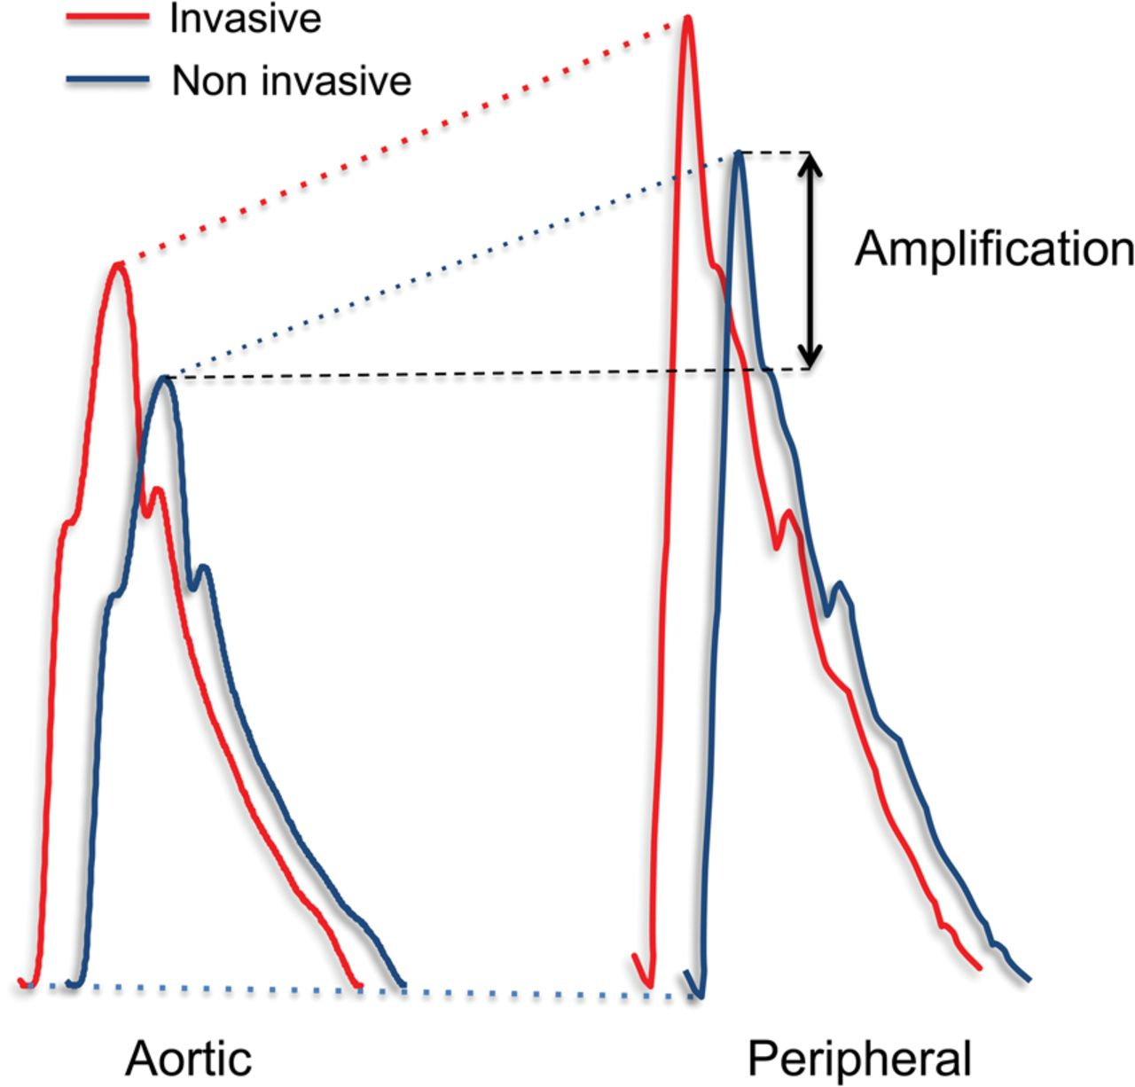
Notes:
Fig: a. Simultaneous aortic and femoral pressure – FA pressure wave has a time delay, peripheral amplification with higher systolic pressure and a “damped” appearance with loss of dicrotic notch. B. A simultaneous aortic and rdial pressure shows the typical “spiked” appearance of peripheral waveform.
-The measured central aortic pressure
is composed of two components: the
pressure wave generated from forward
flow from left ventricular ejection and
the summation of pressure waves generated
from ‘‘reflected’’ waves. Reflected
waves result because as blood is ejected
forward, it meets areas of resistance such
as branch points or tortuous vessels.
When the pressure wavefront strikes
these areas, additional pressure waves are
generated and directed back to the heart.
These pressure waves strike the aortic
valve, generating additional, forwarddirected,
smaller pressure waves. Therefore,
the sampled pressure waveform
represents a summation
-The effect of reflected waves is particularly
notable in peripheral arterial waveforms
(brachial, femoral, and radial)
(Figure 2-22). Peak systolic pressure
exceeds central aortic pressure by
10–20 mmHg due to peripheral amplification
from reflected waves. The contour
of the waveform changes further from
the aortic valve, with a steeper upstroke,
narrower systolic portion (spiked appearance),
and markedly diminished or
absent dicrotic notch.

Slide 24
ARTIFACTS

Slide 25
Notes:
“whip” artifacts seen in pts with hyperdynamic hearts
A- PA waveform unrecognizable
B excessive catheter whip from prominent loop in rt atrium
C removal of loop improved the appearance of waveform
D but, overshoot artifact remained
E filter resulted in further improvement in appearance of waveform

Slide 26
CARDIAC OUTPUT

Slide 27
Cardiac Output
Thermodilution
Fick Method

Slide 28
Thermodilution
Bolus injection of saline into the proximal port
Change in temperature is measured by thermistor in the distal portion of the catheter

Slide 29
Fick Principle
Described in 1870
Assumes rate of O2 consumption is a function of rate of blood flow times the rate of O2 pick up by the RBC
Oxygen consumption
1. Direct Fick:
-Directly measured
2. Indirect Fick:
--3 ml O2/kg
X 10

Slide 30
Limitations
Thermodilution
Fick
Not accurate in tricuspid regurgitation
Overestimated cardiac output at low output states
Oxygen consumption is often estimated by body weight (indirect method) rather than measured directly
Large errors possible with small differences in saturations and hemoglobin.
Measurements on room air

Slide 31
THANK YOU

Slide 32
Normal Pressures
Site | Normal Value (mmHg) | Mean Pressure (mmHg) | Saturation
Right Atrium (or CVP) | 0-5 |  | 75%
Right Ventricle | 25/5 |  | 75%
Pulmonary Artery | 25/10 | 10-20 | 75%
PCWP | 7-12 |  | 95-100%
LV | 120/10 |  | 95-100%
Aorta | 120/80 |  | 95-100%

Slide 33
Normal Values
Site | Value
Sv02 | 0.60-0.75
Stroke Volume | 60-100 ml/beat
Stroke Index | 33-47 ml/beat/m2
Cardiac Output | 4-8 L/min
Cardiac Index | 2.5-4.0 L/min/m2
SVR | 800-1200 dynes sec/-cm5
PVR | <250 dynes sec/-cm5
MAP | 70-110 mmHg

Slide 34
Notes:
Electrical precedes mechanical • ‘a’ wave increase in pressure during atrial contraction (PR interval- ECG) • ‘x’ descent the fall in pressure following the a wave (represents atrial relaxation) • ‘c’ wave may occur as an interruption to the x descent and represents the movement of the AV valve towards the atrium during valve closure. (RS-T junction- ECG) • ‘v’ wave increase in pressure during ventricular systole, with bulging of the AV valve into the atrium. (T-P interval -ECG) • ‘y’ descent the fall in pressure following the v wave (represents opening of the AV valve)
The v wave is usually smaller than the a wave in the right atrium
Inspiration – x and y descent become more prominent on the RA waveform
Chronic afib – persistence of x descent despite loss of a wave

Slide 35
References
Bangalore and Bhatt. Right heart catheterization, coronary angiography and percutaneous coronary intervention. Circulation, 2011; 124: e428-e433.
Kern, Morton J. The Cardiac Catheterization Handbook. Philadelphia, PA: Saunders Elsevier, 2011. Print.
Ragosta, Michael. Textbook of Clinical Hemodynamics. Philadelphia, PA: Saunders/Elsevier, 2008. Print.

